Slide 1
Travel ai agent
CAPSTONE PROJECT
Presented By: Edunet Foundation
Student name : Arpit Dhiman
College Name & Department : Manav Rachna International Institute of Research and studies(MRIIRS)

Slide 2
OUTLINE
Problem Statement
Technology used
Wow factor
End users
Result
Conclusion
Git-hub Link
Future scope
IBM Certifications

Slide 3
Problem Statement
In today's fast-paced world, planning a trip can be a time-consuming and overwhelming task. Travelers often struggle to find the best destinations, compare accommodation and transport options, create optimized itineraries, and manage budget constraints—all while trying to tailor the experience to their unique preferences.
Existing travel platforms are often fragmented, requiring users to switch between multiple apps and websites to gather information, book services, and organize their trips. This not only leads to inefficiencies but also results in suboptimal travel experiences.
There is a need for an intelligent, user-friendly solution that can automate and personalize the travel planning process end-to-end. The solution should leverage artificial intelligence to understand user preferences, analyze real-time data, suggest suitable destinations, build customized itineraries, and recommend optimal transport and accommodation options—all in a seamless and intuitive interface.

Slide 4
Technology used
IBM cloud lite services
Natural Language Processing (NLP)
Retrieval Augmented Generation (RAG)
IBM Granite model

Slide 5
IBM cloud services used
IBM Cloud Watsonx AI Studio
IBM Cloud Watsonx AI runtime
IBM Cloud Agent Lab
IBM Granite foundation model

Slide 6
Wow factors
The Travel AI Agent stands out with its intelligent and highly personalized approach to trip planning. By leveraging artificial intelligence, it can understand user preferences—such as budget, travel duration, and interests—and generate customized, day-wise itineraries that adapt dynamically based on real-time data like weather conditions, transport availability, and local events. One of its most impressive features is the natural language interface, allowing users to plan entire trips through simple conversational commands. Unlike traditional travel apps, this agent acts as a one-stop solution, combining flight and hotel booking, local transportation suggestions, food recommendations, and expense tracking in a unified dashboard. It also offers a smart budget optimization engine that adjusts the travel plan based on financial constraints. With multilingual support and location awareness, it ensures a culturally relevant and inclusive experience. Additionally, the agent provides real-time safety alerts, travel document organization, and calendar integration for seamless coordination. For eco-conscious travelers, it even recommends sustainable travel options. These innovative features collectively make the Travel AI Agent not just a tool, but a truly smart travel companion.

Slide 7
End users
Frequent Travellers
Students and budget travellers
Corporate Travel Planners
Travel Agencies and Agents

Slide 8
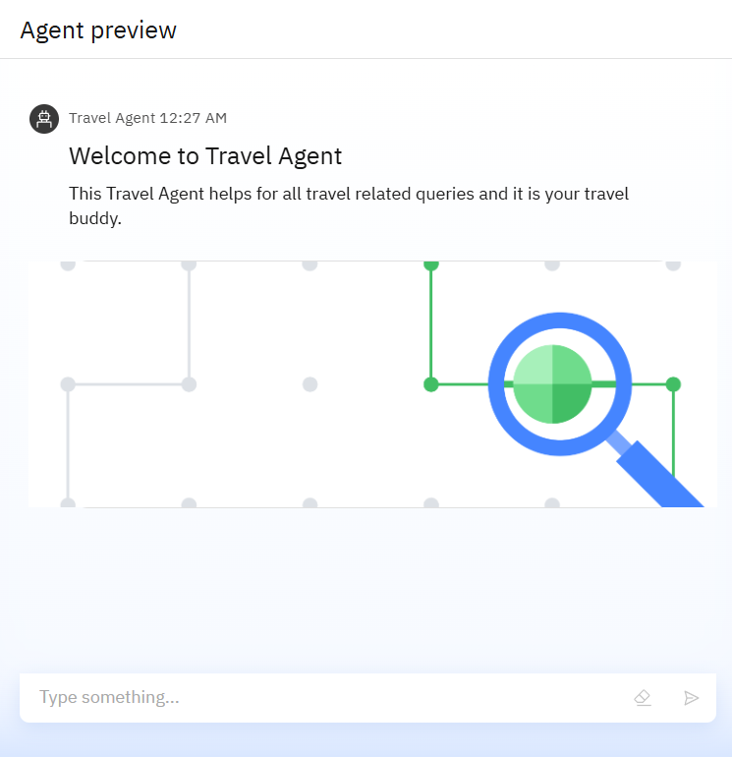
Results

Slide 9
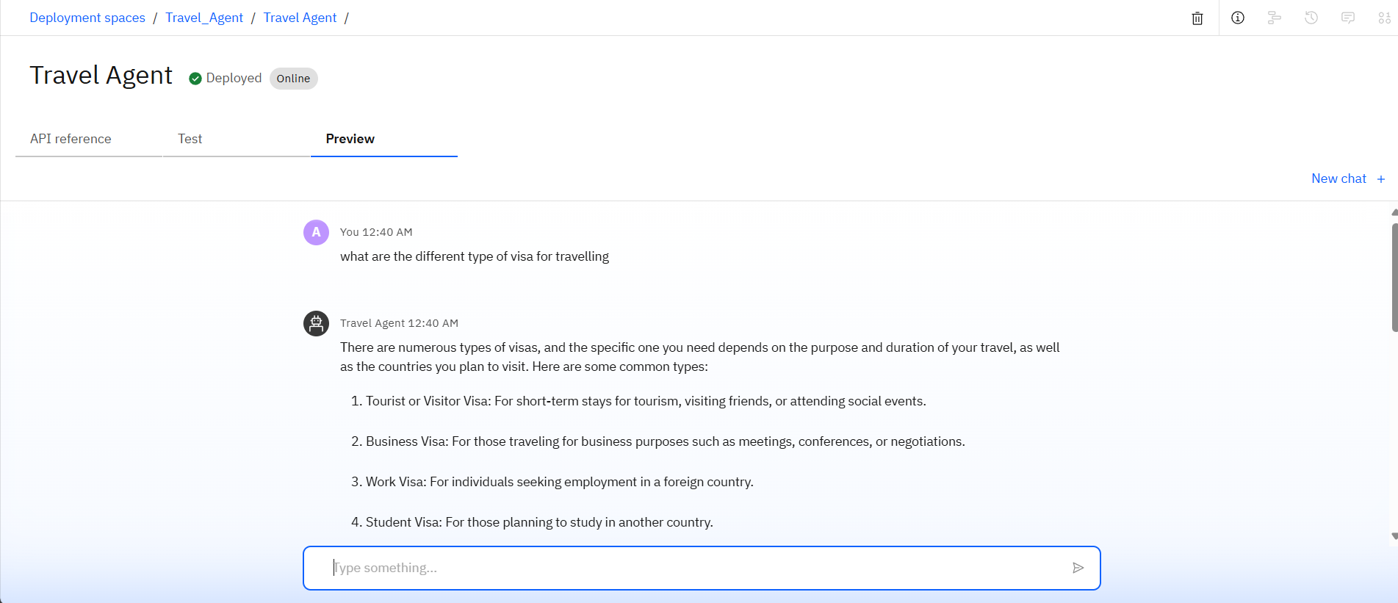
Results

Slide 10
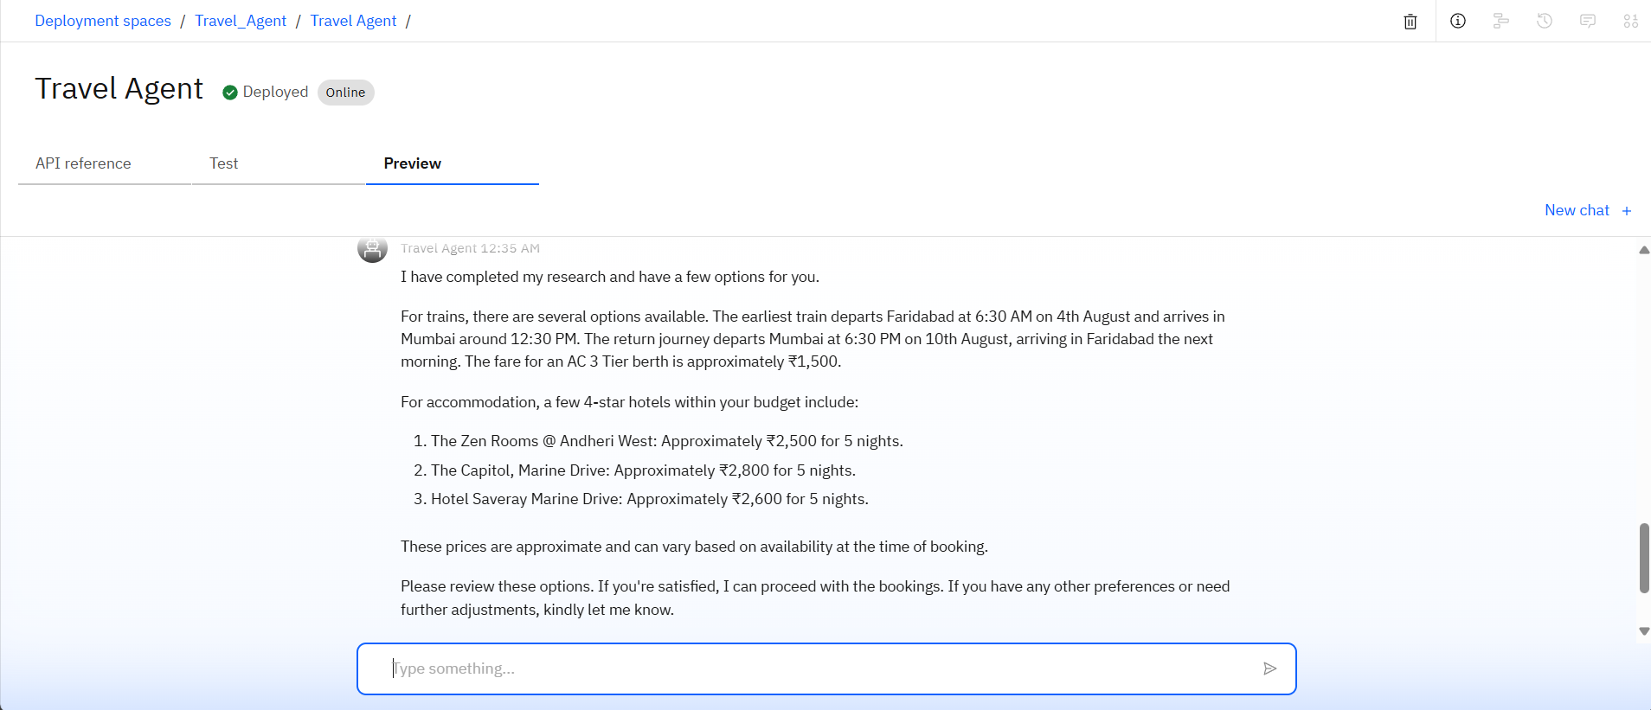
Results
Deployed AI Agent

Slide 11
Conclusion
The Travel AI Agent simplifies and revolutionizes the trip planning process through intelligent automation and real-time data integration.
It addresses the common pain points of modern travelers by offering personalized, budget-friendly, and efficient travel solutions in a single platform.
It enhances safety convenience, and accessibility for various types of travelers- from tourists to business professionals.

Slide 12
GitHub Link
Make sure that there should be readme file

Slide 13
Future scope
Predictive travelling planning
Voice Assistant & Wearable Integration
Social & Group Travel Features
Hyper-Personalization
Multi-Language and cross border support
White-Label SaaS Model

Slide 14
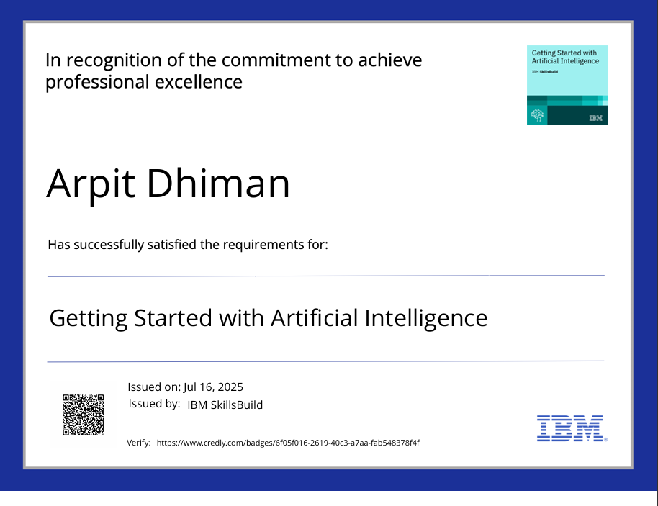
IBM Certifications

Slide 15
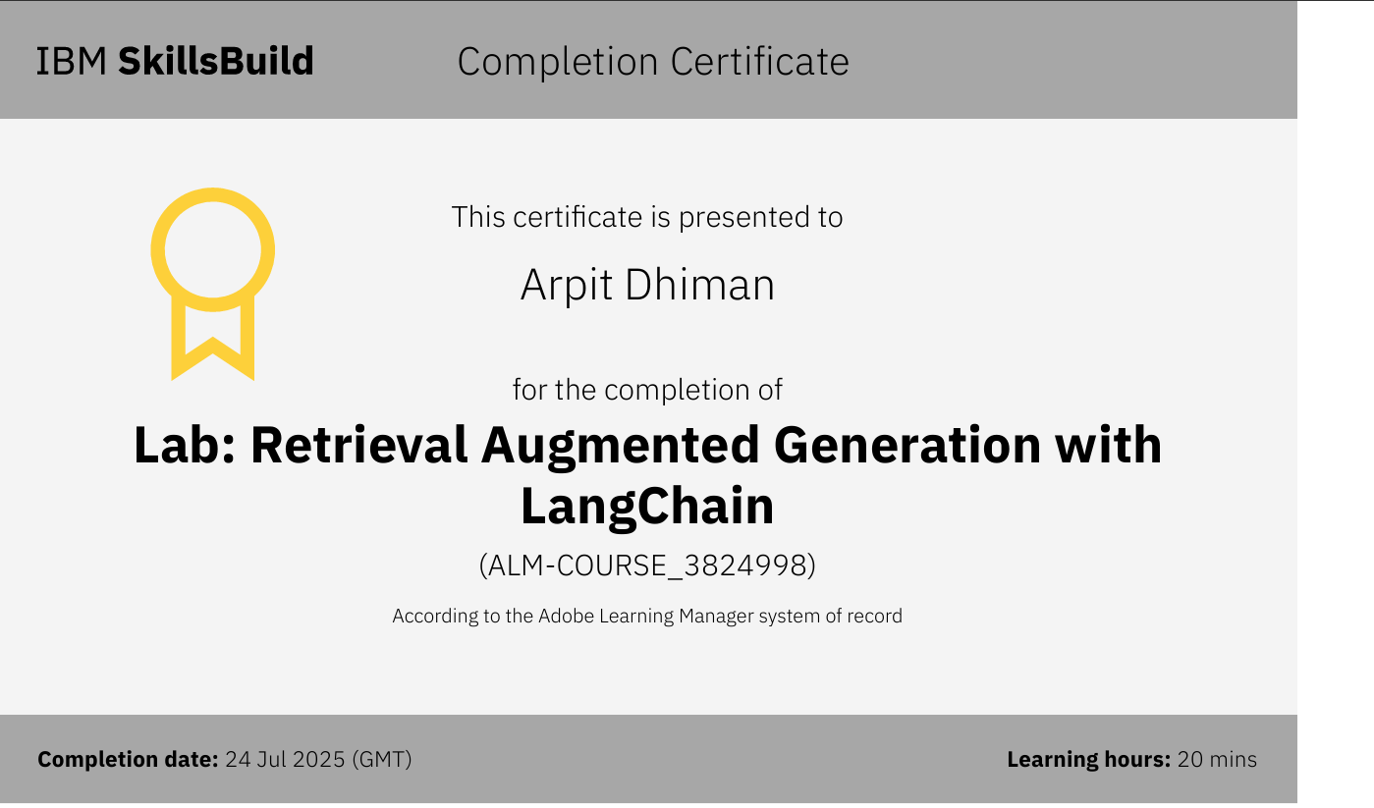

Slide 16
THANK YOU

